Slide 1
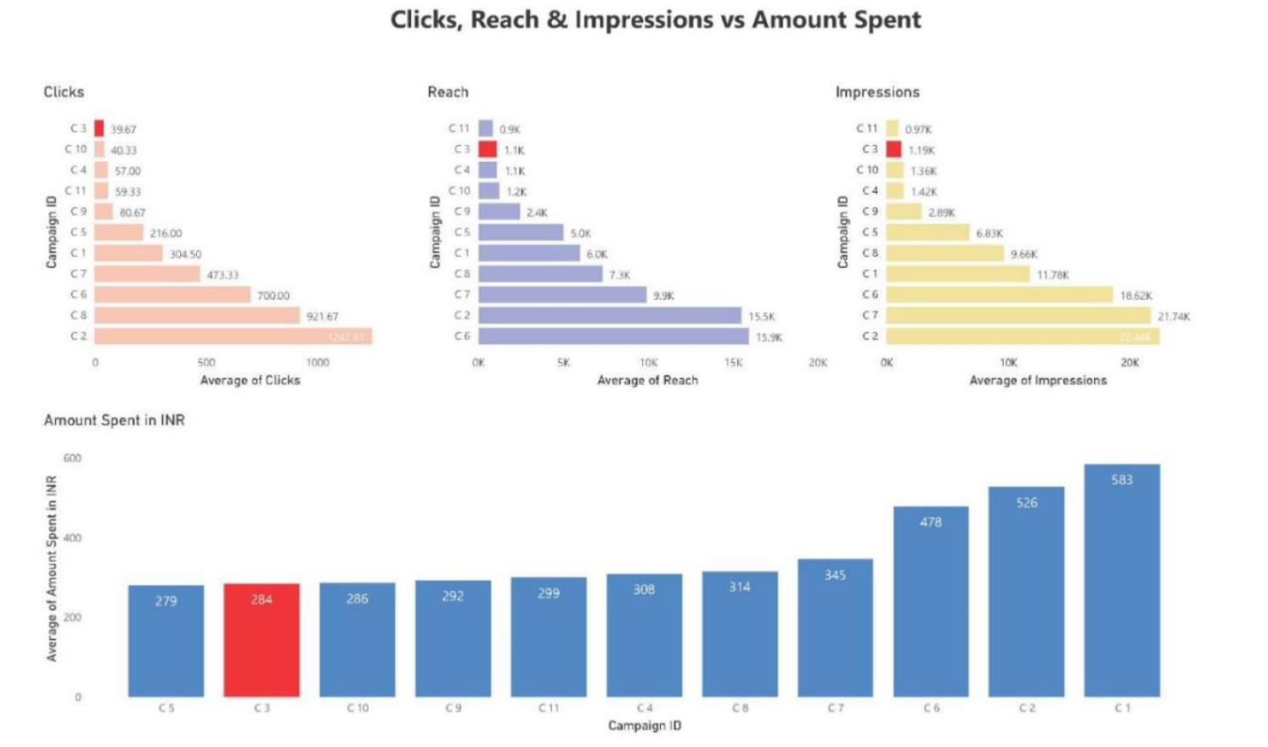
When the campaigns are compared with each other on the basis of Clicks, Reach, Impressions and Amount Spent, we can depict that Campaign 3 was having the least number of Clicks and Reach among its Users.

Slide 2
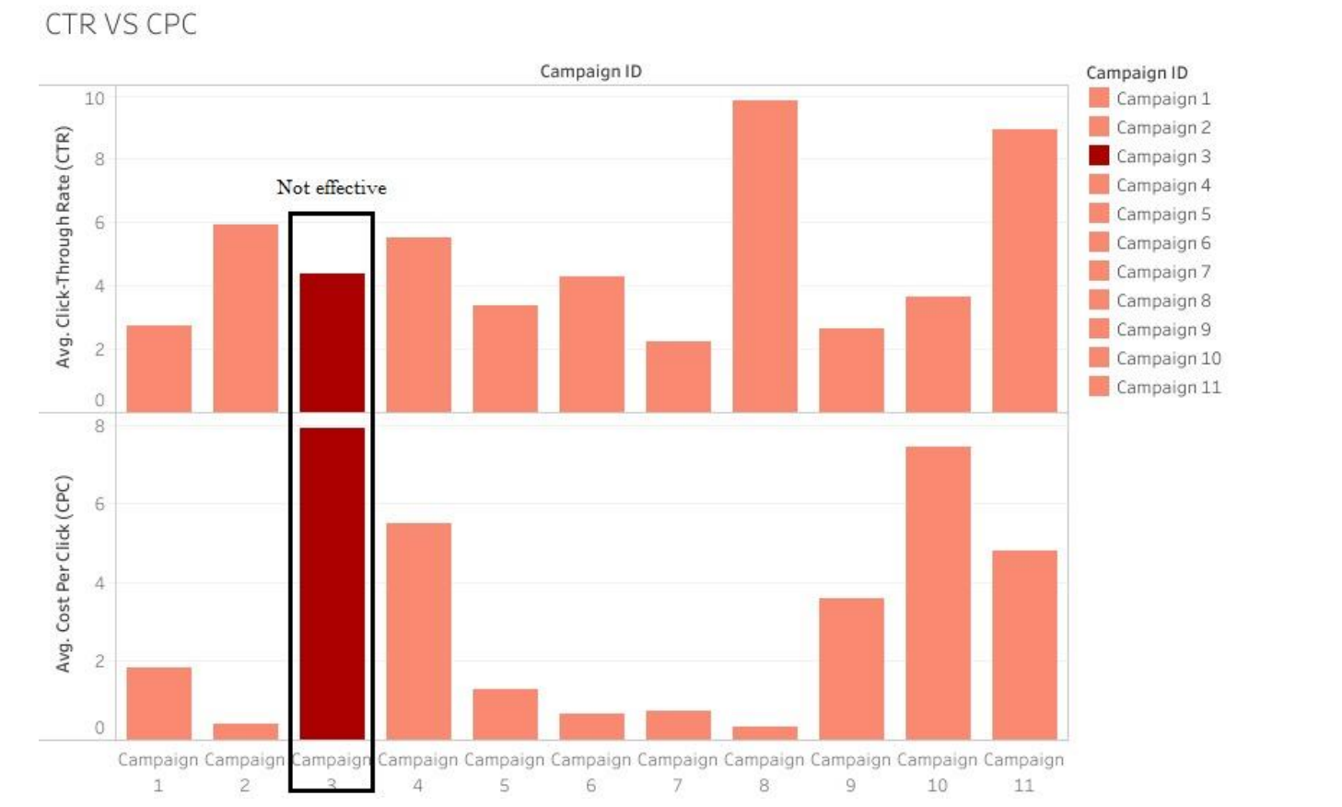
It can be seen that Campaigns 3 has lower Click Through Rates (CTR), but their Costs Per Click (CPC) are higher. Hence, in comparison with the rest of the campaigns 3 is the least cost efficient as it is not able to gain adequate attention of the audience.

Slide 3
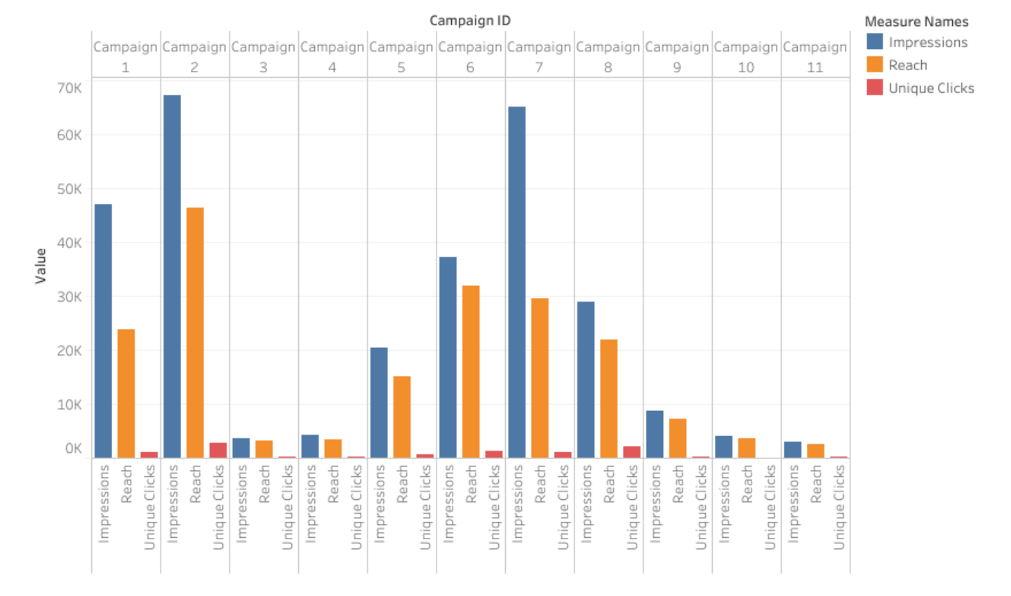
After comparing Impression and Reach with Unique Clicks we can conclude that Campaign 3 has the lowest amount of Reaches and Impressions. Also, it has the less than the Average Unique Clicks when compared with other campaigns.

Slide 4
CONCLUSION
1. After analyzing the dataset given to us, we can comprehend that there are several factors which we can be considered to decide whether to continue a particular campaign or not.
2. After a brief discussion we have decided that the most important factors to be considered for discontinuing a campaign are Reach, Clicks, Impressions, Amount spent in INR, and Unique Clicks.
3. After visualizing and comparing the results, we came to a conclusion that Campaign 3 is having the lowest number of reaches and impressions, while also having a higher amount spent. Therefore, Campaign 3 can be considered for removal due to their low result and cost efficiency.

